Slide 1
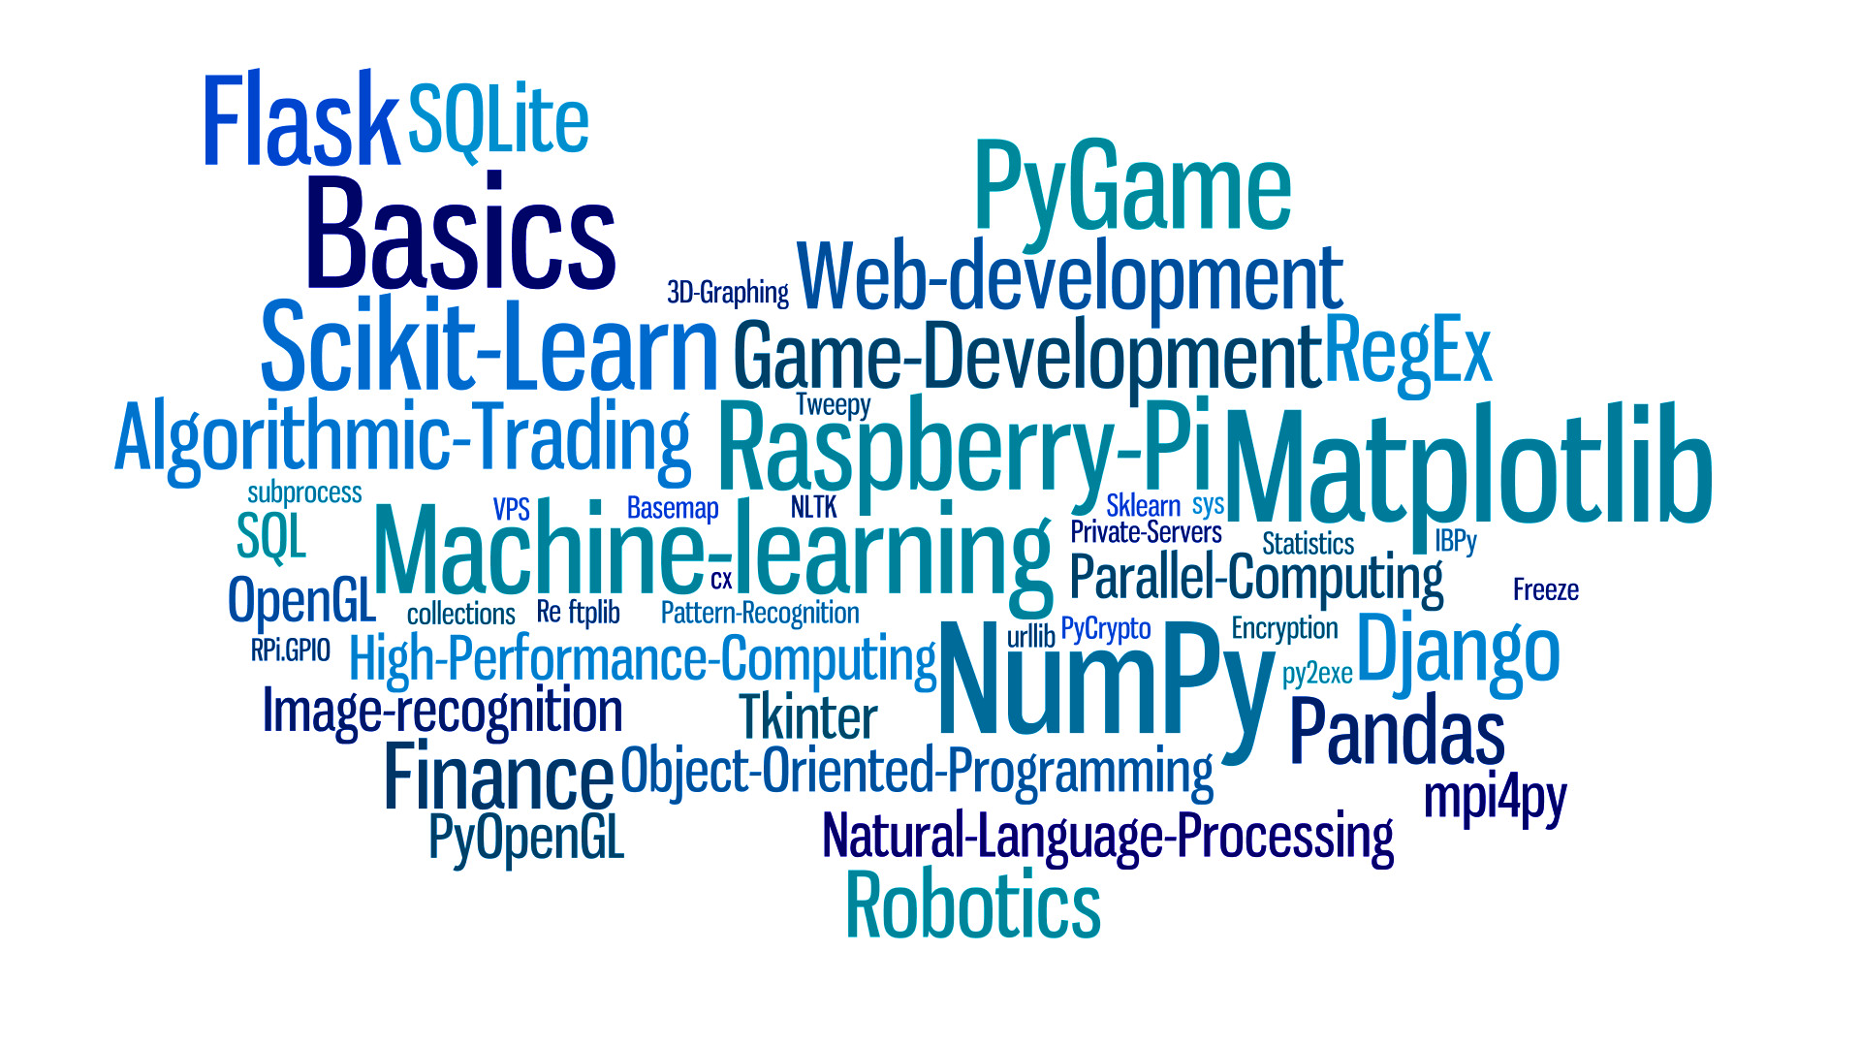
Getting started with Python

Slide 2
Python Versions – Life cycle
Oct 2020 – Oct 2025
Oct 2019 – Oct 2024
Python 3.8
Jun 2018 – Jun 2023
Python 3.7
Python 3.9
Dec 2016 – Dec 2021
Python 3.6
Jul 2010 – Jan 2020
Python 2.7 (EOL)

Slide 3
Where we can use python
Web Development
Game Development
Machine Learning and Artificial Intelligence
Data Science and Data Visualization
Desktop GUI
Business Applications
Audio and Video Applications
Embedded Applications
etc.

Slide 4
Installing python
Download python executable from python.org
Double Click on executable make sure to check mark “✅ Add Python 3.X to PATH”
If you’re not having Elevated/Admin rights on machine, can uncheck “Install launcher for all users (recommended)”, it will be installed only for you.
Installation will be completed in few seconds. Click close.
Some important files locations –
C:\Users\kamal\AppData\Local\Programs\Python\Python39\python.exe → (python)
C:\Users\kamal\AppData\Local\Programs\Python\Python39\Scripts\pip.exe → (pip)

Slide 5
Notes and demo code
You can find the code in Git Repo →
https://github.com/kamalk8s/getting-started-with-python.git
This presentation will also be available there.

Slide 6
Python Variables / Datatypes
Numeric data types: int, float, complex
String data types: str
Sequence types: list, tuple, range
Binary types: bytes, bytearray, memoryview
Mapping data type: dict
Boolean type: bool
Set data types: set, frozenset

Slide 7
Demo 1 – Python Variables
Code will be available in GitHub Repository → 01. Python Variables

Slide 8
Python Arithmetic Operators
Operator Name Example
+ Addition x + y
- Subtraction x - y
* Multiplication x * y
/ Division x / y
% Modulus x % y
** Exponentiation x ** y
// Floor division x // y

Slide 9
Python Comparison Operators
Operator Name Example
== Equal x == y
!= Not equal x != y
> Greater than x > y
< Less than x < y
>= Greater than or equal to x >= y
<= Less than or equal to x <= y

Slide 10
Python Logical Operators
Operator Description Example
and Returns True if both statements are true x < 5 and x < 10
or Returns True if one of the statements is true x < 5 or x < 4
not Reverse the result not(x < 5 and x < 10)
For more type of operators, please check w3scools docs

Slide 11
If elif else statements
x = 100
if x < 100:
print('x is smaller than 100')
elif x > 100:
print('x is greater than 100')
else:
print('x is 100')

Slide 12
FOR & while loops
# For Loop
for i in range(1,10):
print(i)
# While Loop a = 0
while a < 15:
print(str(a) + ' is still smaller than 15')
a += 1

Slide 13
Functions in python
# Defining the Function
def sum(arg1, arg2):
return arg1+arg2
# Let’s use Function
Num1 = int(input('Please Enter 1st number: '))
num2 = int(input('Please Enter 2nd number: ’))
print('Sum: ’ + str(sum(num1, num2)}))

Slide 14
Demo 2 – statements
Code will be available in GitHub Repository → 02. Statements

Slide 15
Demo 3 – Loops
Code will be available in GitHub Repository → 03. Loops

Slide 16
Demo 4 – functions
Code will be available in GitHub Repository → 04. Functions

Slide 17
Understanding few concepts
How to import modules.
How to install External Modules using PIP. Check https://pypi.org for list or all external modules available.
How to utilize virtual environment, so that you can keep projects separate from each other.
Activating Virtual Environment –
For Windows .\env\scripts\activate.ps1
For Linux source ./env/scripts/activate
How to make projects portable in terms of module dependencies and OS independent.
Using pip freeze > requirements.txt to freeze all dependencies (modules) and then,
Using pip install requirements.txt to install dependency (modules) in bulk.

Slide 18
Demo 5 – Flask Hello world
Code will be available in GitHub Repository → 05. Flask Hello World
Steps
Get inside folder cd ‘05. Flask Hello World’
Install pip install virtualenv
Create virtual environment virtualenv <env_name>
Enable newly create Virtual environment .\<path-to-env>\<env_name>\scripts\activate.ps1
You can confirm if you’re in Virtual Environment or not. If you’re inside virtual environment, it will be visible in terminal and VS code as well.
Install requirements using pip install –r requirements.txt
Run the application by typing python main.py

Slide 19
What’s next
Setting up proxy in ENV variable, so that pip can install modules in our organization.
HTTP_PROXY = <URI of proxy>
HTTPS_PROXY = <URI of proxy>
Learning python in deep
Python by Jose Portilla
Check out my Flask app starter template, you don’t have to write code from beginning always.
https://github.com/kamalk8s/flask-init.git

